Slide 1
Practice Activity Number 2
File created on: 3/15/2021 10:01:43 AM

Slide 2
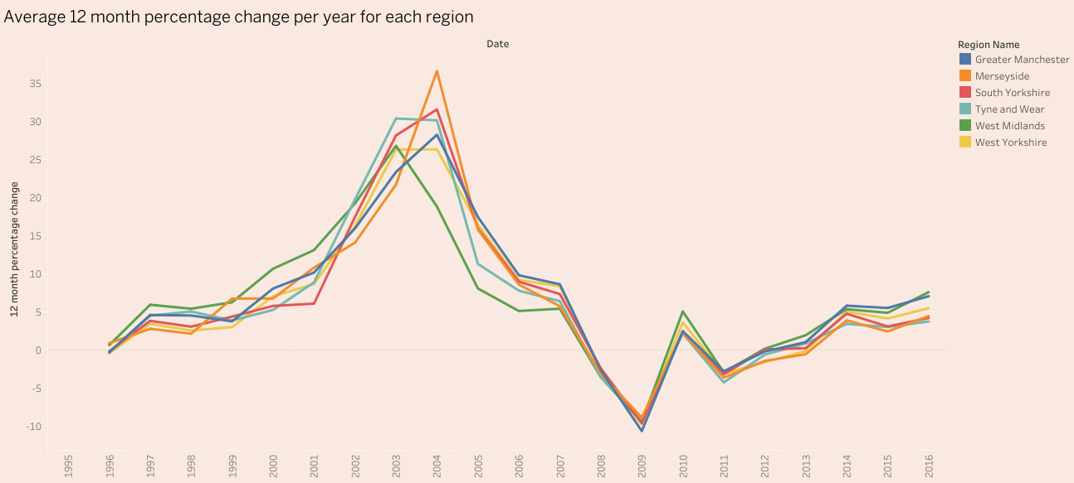

Slide 3
